Slide 1

Reddit NLP
Christopher Denq
(Askreddit vs. askscience)

Slide 2
Problem Statement
Methodology
Analysis
Conclusion

Slide 3
Problem Statement
Methodology
Analysis
Conclusion

Slide 4
Goal Give targeted ads to users
Intro Problem Statement Methodology Analysis Conclusion

Slide 5
Goal Give targeted ads to users
Classify both users
Intro Problem Statement Methodology Analysis Conclusion

Slide 6
Goal Give targeted ads to users
Classify both users
Solution Pre-trained classification
models
Intro Problem Statement Methodology Analysis Conclusion

Slide 7
Problem Statement
Methodology
Analysis
Conclusion

Slide 8
Solution: Pre-trained Models
Intro Problem Statement Methodology Analysis Conclusion

Slide 9
Solution: Pre-trained Models
Data Gathering w/ Pushshift
Intro Problem Statement Methodology Analysis Conclusion

Slide 10
Solution: Pre-trained Models
Data Gathering w/ Pushshift
Cleaning & EDA w/ Python
Intro Problem Statement Methodology Analysis Conclusion

Slide 11
Solution: Pre-trained Models
Data Gathering w/ Pushshift
Cleaning & EDA w/ Python
NLP Modeling w/ CVEC & TFIDF
Intro Problem Statement Methodology Analysis Conclusion

Slide 12
Solution: Pre-trained Models
Data Gathering w/ Pushshift
Cleaning & EDA w/ Python
NLP Modeling w/ CVEC & TFIDF
Out-of-box Solution
Intro Problem Statement Methodology Analysis Conclusion

Slide 13
Question: By how much?
Training Dataset
(19k, 18k)
Log Reg
RF
Stacked
CVEC
TFIDF
Log Reg
RF
Stacked
Intro Problem Statement Methodology Analysis Conclusion

Slide 14
Problem Statement
Methodology
Analysis
Conclusion

Slide 15
Goal Classify both users equally
Intro Problem Statement Methodology Analysis Conclusion

Slide 16
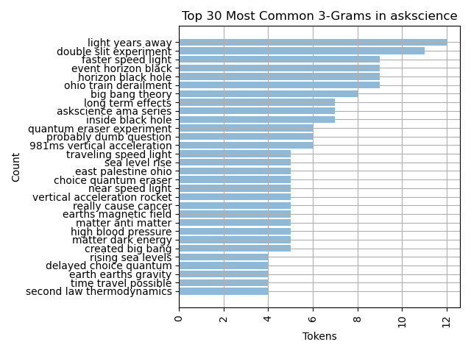
Intro Problem Statement Methodology Analysis Conclusion

Slide 17
Intro Problem Statement Methodology Analysis Conclusion

Slide 18
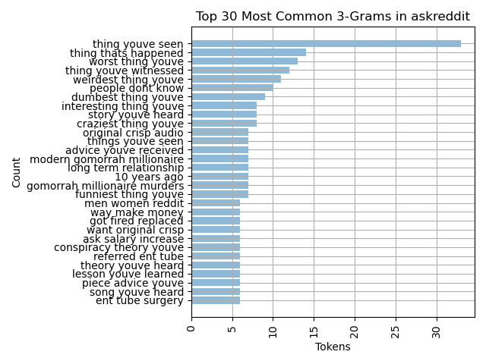
Intro Problem Statement Methodology Analysis Conclusion

Slide 19
Intro Problem Statement Methodology Analysis Conclusion

Slide 20
Solution Pre-Trained Models
Intro Problem Statement Methodology Analysis Conclusion

Slide 21
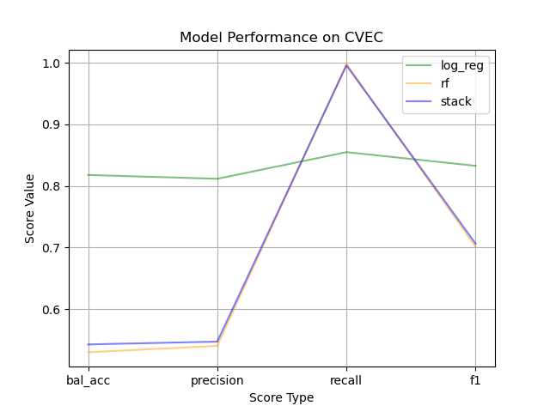
Intro Problem Statement Methodology Analysis Conclusion

Slide 22
Intro Problem Statement Methodology Analysis Conclusion

Slide 23
Intro Problem Statement Methodology Analysis Conclusion

Slide 24
Problem Statement
Methodology
Analysis
Conclusion

Slide 25
Recommendation
Intro Problem Statement Methodology Analysis Conclusion

Slide 26
Recommendation
Logistic regression @ 0.82 balanced accuracy
Intro Problem Statement Methodology Analysis Conclusion

Slide 27
Recommendation
Logistic regression if want both
Random forest if specifically want AskScience
Intro Problem Statement Methodology Analysis Conclusion

Slide 28
Executive Takeaway
This project can save you time and money by offering pre-trained models for your future Reddit projects!
Intro Problem Statement Methodology Analysis Conclusion

Slide 29
Thank you!
Questions?

